Slide 1
Fabric Network
Runtime Architecture
2020.12

Slide 2
Content
Architecture Overview
Component
Relationship
Conclusion

Slide 3
Part 1: Architecture Overview

Slide 4
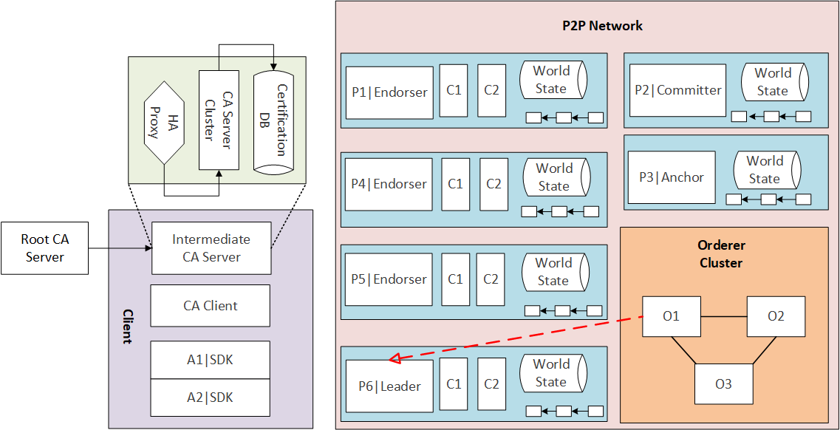
Architecture Overview

Slide 5
Part 2: Component

Slide 6
Component
Peer
Orderer
CA
Client

Slide 7
1. Peer
Roles
Committer
Endorser
Anchor
Leader

Slide 8
1. Peer
Roles
Endorser Proxy:
P = {AND(P1, P2), OR(P1, P2), OutOf(m, P1, P2, ..., Pn), m <= n}
【策略实例】

Slide 9
1. Peer
Chain Code

Slide 10
1. Peer
Ledger
Blockchain
World State DB

Slide 11
1. Peer
Ledger
Private Data
Private Block
Private DB

Slide 12
1. Peer
Gossip Protocol

Slide 13
2. Orderer
【】

Slide 14
2. Orderer
Order Proxy

Slide 15
3. CA
CA Server
Root CA
Intermediate CA

Slide 16
3. CA
CA Client

Slide 17
3. CA
MSP

Slide 18
4. Client
Application

Slide 19
4. Client
SDK

Slide 20
Part 3: Relationship

Slide 21
Relationship
Channel
Organization
Cluster

Slide 22
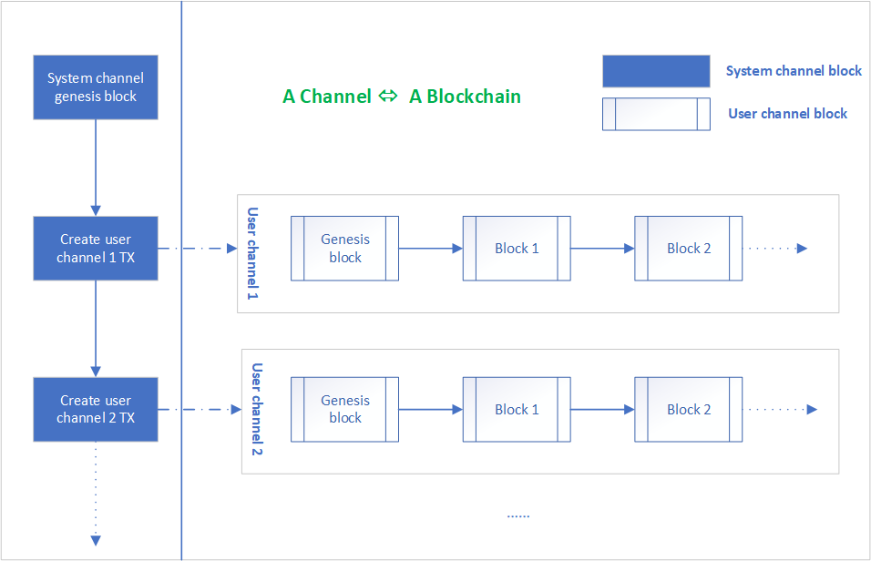
1. Channel

Slide 23
2. Organization

Slide 24
3. Cluster

Slide 25
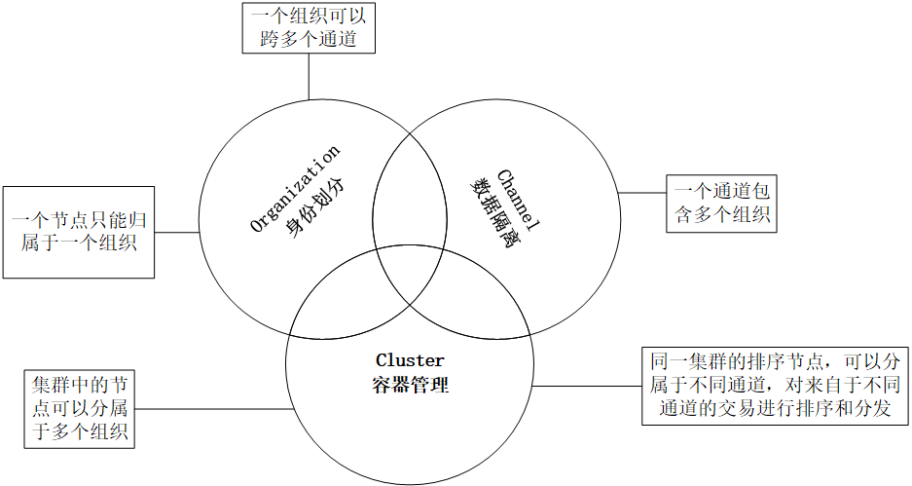

Slide 26
Part 4: Conclusion

